Slide 1
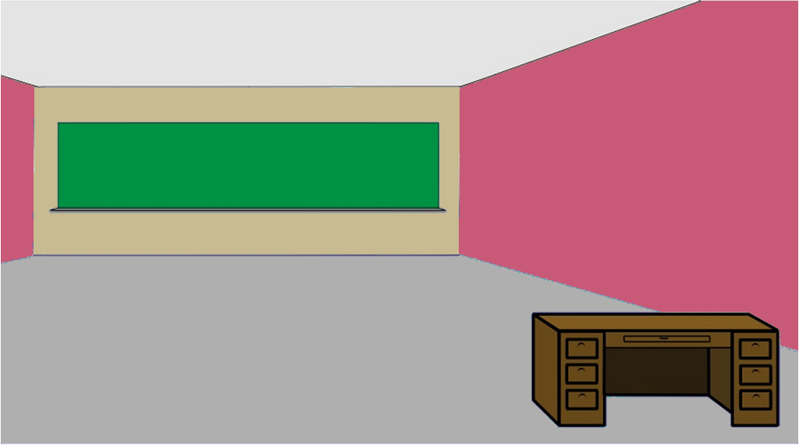









Figure 1. LEARN Task.
A
They will say something….
Typing…
B
Your avatar sucks!
Mean
Nice
C
Prediction
4 seconds
Your avatar sucks!
Feedback
3 seconds
You’re Mean
You’re Wrong
You’re Right
You’re Nice
Response
4 seconds
Notes:
Each social interaction trial includes portions A-C followed by an inter-trial interval.

Slide 2
Figure 2. Model Validation of M10a
Mpred
Munpred
Nunpred
Npred
1.00
0.75
Non-SA
Clinical SA
Model Predicted Value
Average Prediction Proportion
0.50
0.25
0.00
Nice
Mean
Nice
Mean
Nice
Mean
Nice
Mean
Prediction
Notes:
Compares youth with clinically significant SA ($≥$7) vs subclinical or no SA ($<$7) on actual and simulated learning in the last 8 trials across social contexts. The x-axis reflects the predicted valence of feedback, y-axis reflects the average proportion of the predicted choice.
***chloe: I can’t find this adjusted code, so I am doing some manual editing things if needed, I can find the code or remake the code with old code I do have

Slide 3
Figure 3. Parameters of Social Learning Across Contexts and SA
A
B
Learning Rate
Associative Value
*
*
*
*
*
Average Simulated Learning Rate
Average Simulated Associative Value
*
Non SA
Low SA
High SA
Clinical SA
Mpred
Munpred
Nunpred
Npred
Mpred
Munpred
Nunpred
Npred
Reputation
Reputation
Notes:
Compares youth with clinically significant SA ($≥$7) vs subclinical or no SA ($<$7) on parameter estimates of A) learning rates and B) associative values across social contexts.

Slide 4
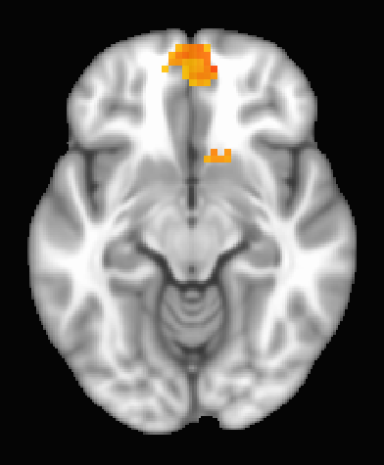
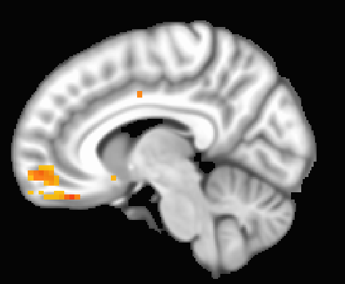
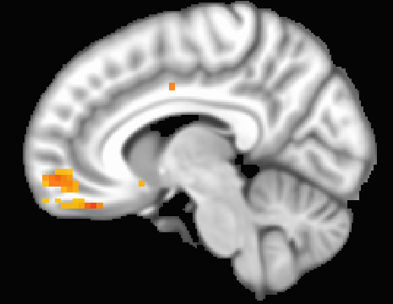
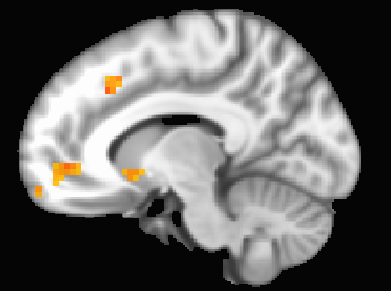
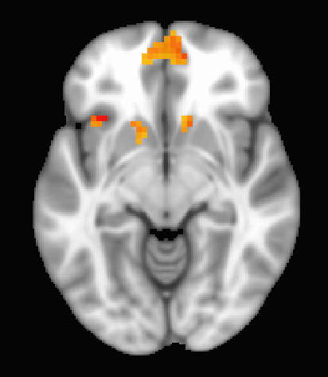
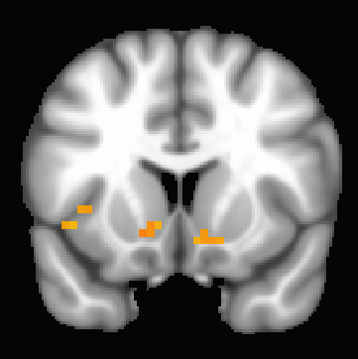
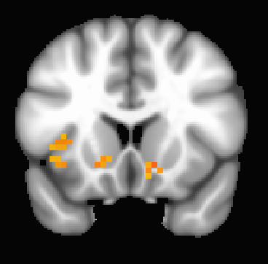
Figure 4. Reputation-Based Prediction Error: Valence by Predictability by SA.
A
B
C
D
z= -10
x= -7
x= 10
x= -7
E
F
G
z= -7
y= -13
y= -16
Notes:
bilateral vmPFC, B) right vmPFC, C) Left Anterior dACC, D) Right Posterior dACC, E) Left Anterior Insula F) Left Ventral Striatum, G) Right Ventral Striatum
**should be pos 13, and pos 16 for bottom row Ys

Slide 5
Figure 5. Decomposition of Reputation-Based Prediction Error: Valence by Predictability by SA
Bilateral vmPFC
A.
B.
Unpredictable (Munpred, Nunpred)
Predictable (Mpred, Npred)
Non-SA
SA
Non-SA
SA
Effect Size of Reputation-Based Prediction-Error on Activation
Nice- reputation
Mean - reputation
SA Diagnostic Cutoff
Social Anxiety Symptoms
Notes:
The x-axis is social anxiety centered at 7, thus values on the right side of the dotted line represent youth with clinically significant SA and values on the left side of the dotted line represent youth without SA. The y-axis is the effect size of the reputation-based prediction error on the neural signal in each region, with larger numbers indicating greater increases or decreases in brain activation. The graphs on the left-side show the relations between valence and SA while receiving feedback from unpredictable peers (Mean60-blue or Nice60-pink), and graphs on the right-side show relation these relations while receiving feedback from predictable peers (Mean80-blue or Nice80-pink). Black marks on the x-axis represent participant data range. * indicate a significant valence by SA interaction, bars indicate a significant difference in activation by SA within valence.

Slide 6
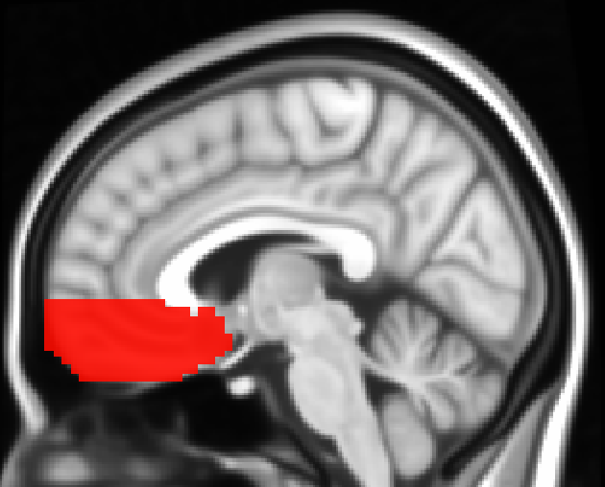
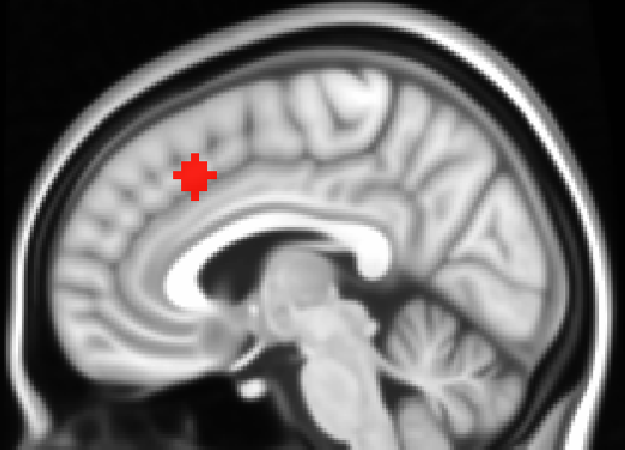
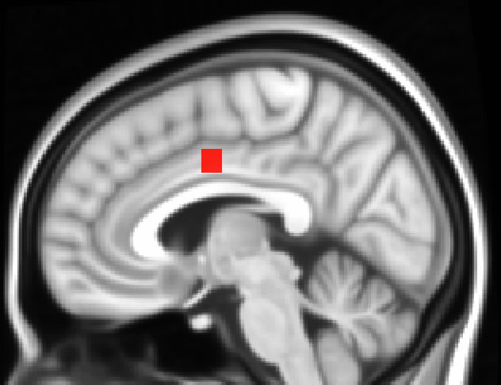
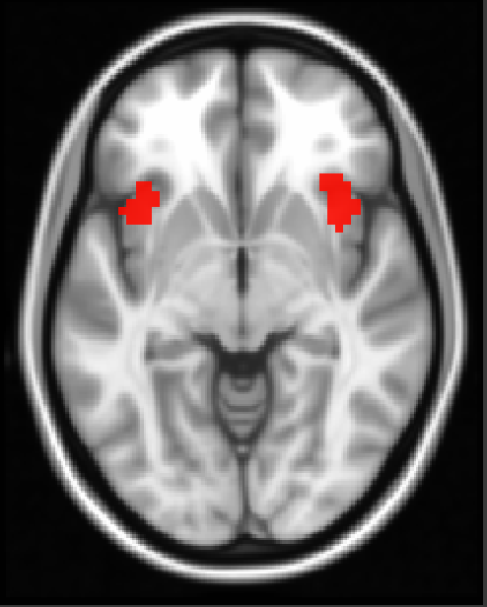
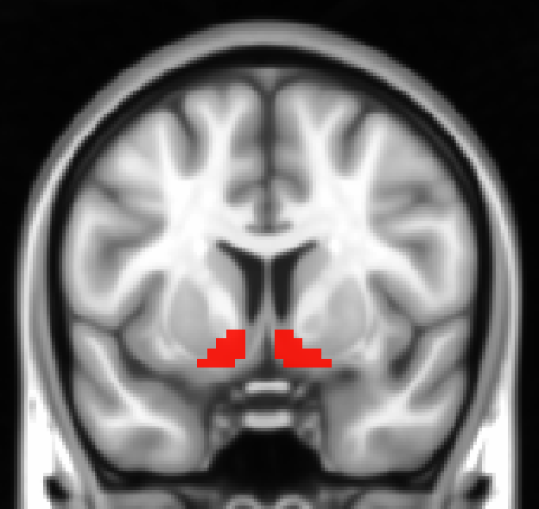
Figure S1. Apriori Network Mask Sub-regions.
A
B
C
x= -3
x= -5
x= -5
D
E
z= -4
y= -11
Notes:
Bilateral- A) vmPFC, B) anterior dACC, C) posterior dACC, D) anterior insula, E) ventral striatum

